Slide 1
Inaccurate Revenue Forecasting
2025
December 01, 2025
30 Day Applied Business Strategy Challenge – Day 1

Slide 2
Inaccurate Revenue Forecasting
2025
Objective
Objective
Approach
Analysis
Insights & Recommendations
30 Day Applied Business Strategy Challenge – Day 1

Slide 3

Inaccurate Revenue Forecasting
2025
Objective
To assess the accuracy of our revenue forecasts, identify the sources of error across products and model versions, evaluate the role of external factors, and determine fast, actionable improvements to strengthen forecasting reliability.
30 Day Applied Business Strategy Challenge – Day 1

Slide 4
Inaccurate Revenue Forecasting
2025
Approach
Objective
Approach
Analysis
Insights & Recommendations
30 Day Applied Business Strategy Challenge – Day 1

Slide 5

Inaccurate Revenue Forecasting
2025
Approach
Evaluate the current forecasting performance
Assessed portfolio-level trends and quantified error using MAPE and bias to understand the scope of misalignment.
Identify where the model fails
Compared accuracy across products and model versions to isolate instability and recurring weaknesses.
Examine external drivers
Analyzed whether macro demand or marketing intensity contributed to error variability.
Apply rapid accuracy improvement
Designed and tested a simple calibration overlay to assess how much accuracy could be gained without new model development.
30 Day Applied Business Strategy Challenge – Day 1

Slide 6
Inaccurate Revenue Forecasting
2025
Analysis
Objective
Approach
Analysis
Insights & Recommendations
30 Day Applied Business Strategy Challenge – Day 1

Slide 7
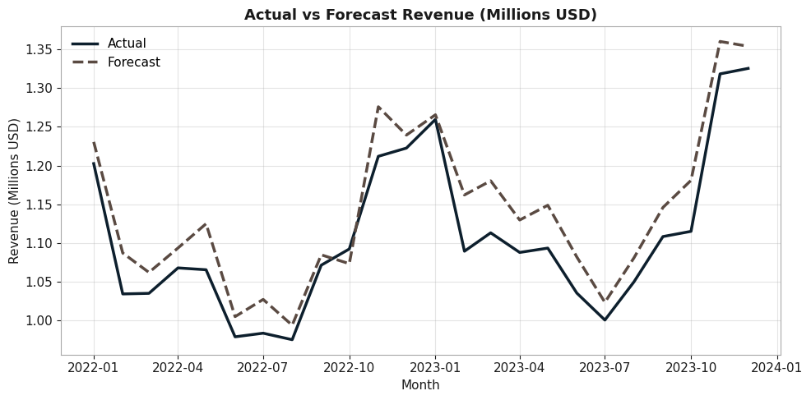
Inaccurate Revenue Forecasting
2025
Analysis
How accurate is the overall revenue forecast?
Forecasts follow overall trend but fail to capture short-term fluctuations
Largest deviations occur during seasonal peaks and macro-driven shifts
Forecast tends to lead actual performance during rapid growth periods
30 Day Applied Business Strategy Challenge – Day 1

Slide 8
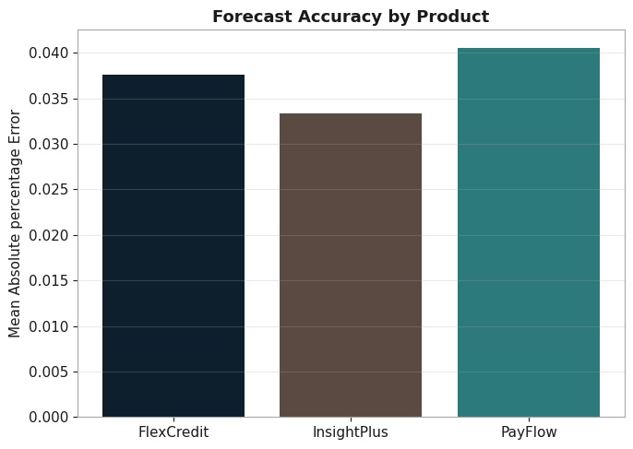
Inaccurate Revenue Forecasting
2025
Analysis
Which products contribute most to forecasting error?
PayFlow shows the highest error and greatest volatility
InsightPlus is consistently stable across months
FlexCredit demonstrates moderate, steady error patterns
30 Day Applied Business Strategy Challenge – Day 1

Slide 9
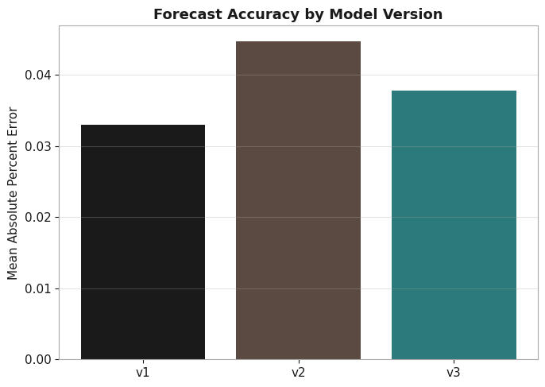
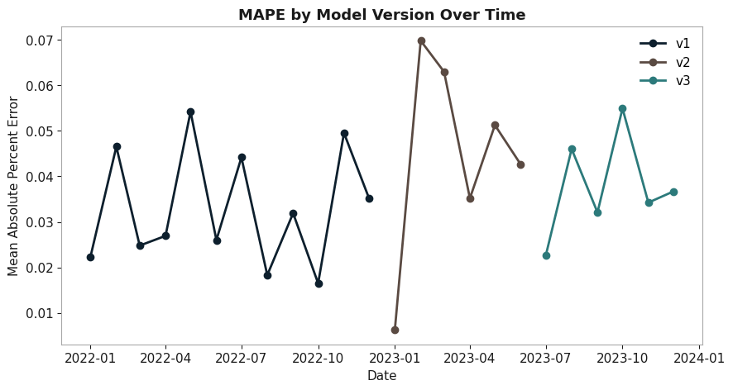
Inaccurate Revenue Forecasting
2025
Analysis
Did newer model versions improve accuracy?
v3 performs better than earlier versions in mid-year
v2 exhibits the weakest performance across variants
Model upgrades do not deliver consistent improvement
30 Day Applied Business Strategy Challenge – Day 1

Slide 10
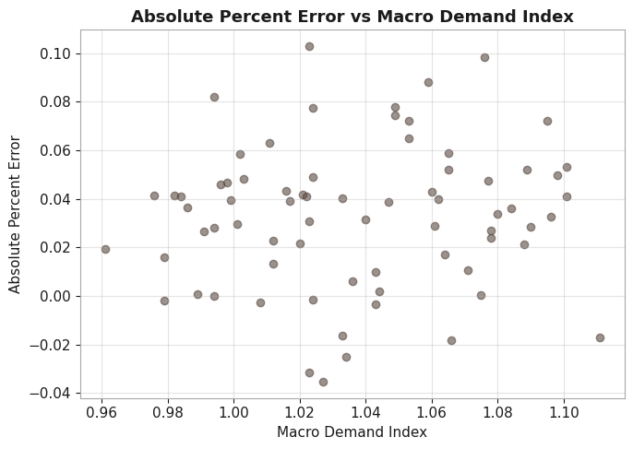
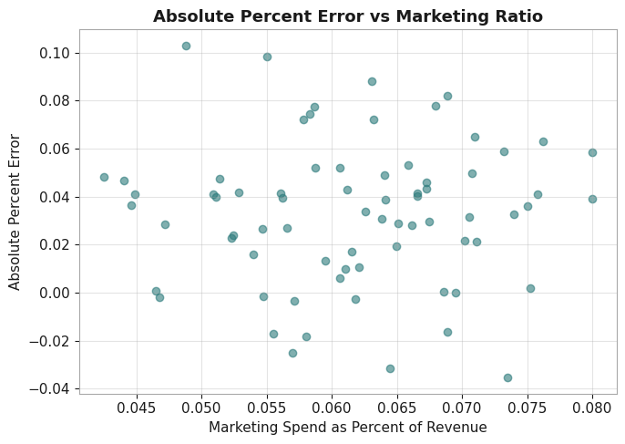
Inaccurate Revenue Forecasting
2025
Analysis
Do external factors influence forecasting error?
Macro Demand Index shows moderate correlation with error
Forecasting error increases during periods of macro volatility
Marketing Ratio shows minimal influence on forecast accuracy
30 Day Applied Business Strategy Challenge – Day 1

Slide 11
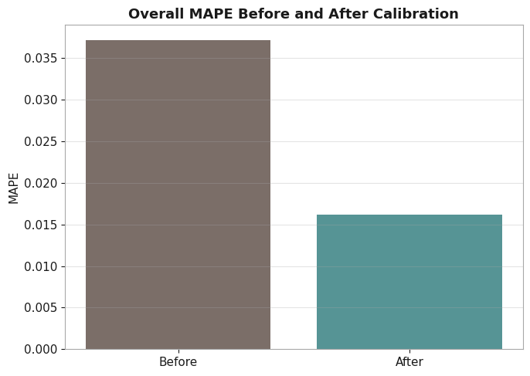
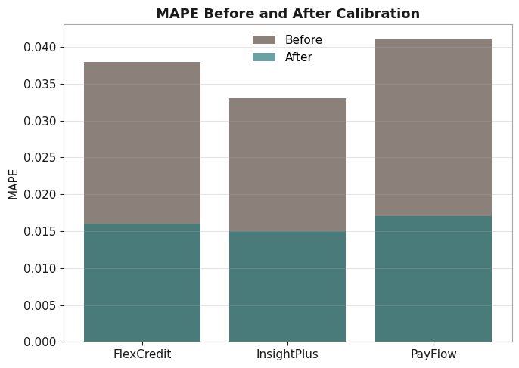
Inaccurate Revenue Forecasting
2025
Analysis
Can accuracy improve without rebuilding the model?
Calibration significantly reduces MAPE across products
Provides immediate accuracy uplift with minimal effort
Stabilizes short-term performance while deeper fixes are explored
30 Day Applied Business Strategy Challenge – Day 1

Slide 12
Inaccurate Revenue Forecasting
2025
Insights &
Recommendations
Objective
Approach
Analysis
Insights & Recommendations
30 Day Applied Business Strategy Challenge – Day 1

Slide 13
Inaccurate Revenue Forecasting
2025
Insights
Forecasts capture trend but not short-term shifts or seasonality.
PayFlow contributes most to overall volatility.
Model version upgrades are inconsistent.
Macro-demand movements drive a meaningful portion of forecast error.
Calibration provides fast, significant accuracy improvement.
30 Day Applied Business Strategy Challenge – Day 1

Slide 14
Inaccurate Revenue Forecasting
2025
Recommendations
Add seasonality and macro-demand features to forecasting logic.
Prioritize refinement of PayFlow forecasting through segmentation.
Establish a structured model version governance and testing process.
Monitor macroeconomic indicators monthly for proactive adjustments.
Deploy calibration overlay as an immediate accuracy improvement mechanism.
30 Day Applied Business Strategy Challenge – Day 1

Slide 15
Thank
You!
30 Day Applied Business Strategy Challenge – Day 1

